Slide 1
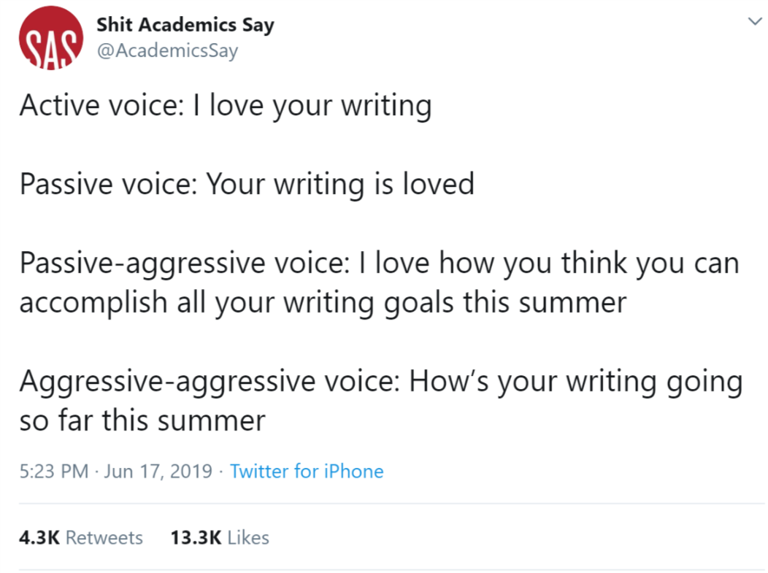
Annotated Bibliographies etc.

Slide 2
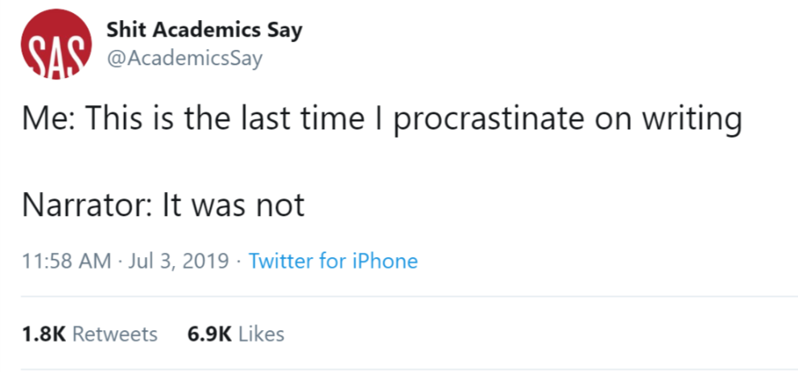
What are we doing today
Talking about annotated bibliographies
APA format brief review
Brief intro to measures and methods
Notes:
- If you need help with your annotated bibliography – I will have office hours on Friday from about 9-11 am

Slide 3
Why are we doing an annotated bibliography?
Because you have to
Notes:
But also:
You have two references read for your literature review of your final draft
It gives you an idea of what questions are left to be answered about your topic
Gets you back into the swing of academic writing
Gives you ideas about how to create your methodology
Does anyone have any questions about the annotated bibliography assignment?

Slide 4
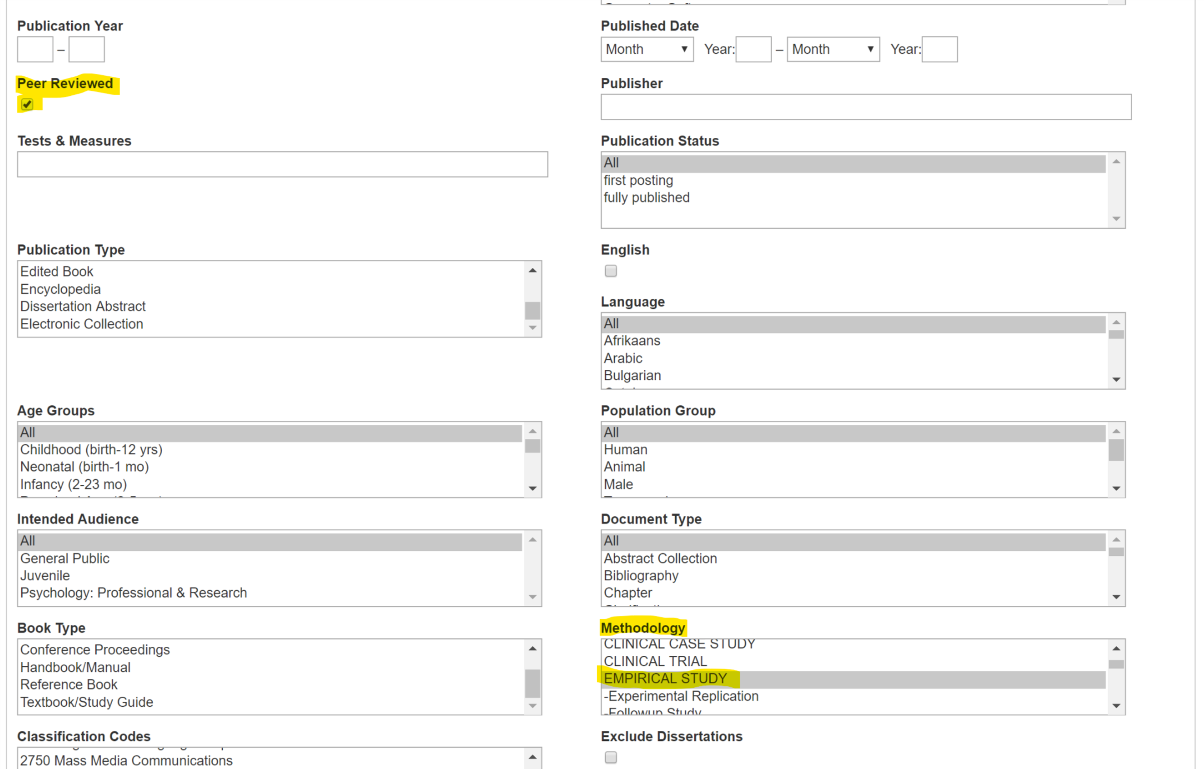
PSYCINFO
Notes:
When you look for articles on PSYCINFO
Make sure you click peer reviewed
Make sure you select empirical from the methodology section

Slide 5
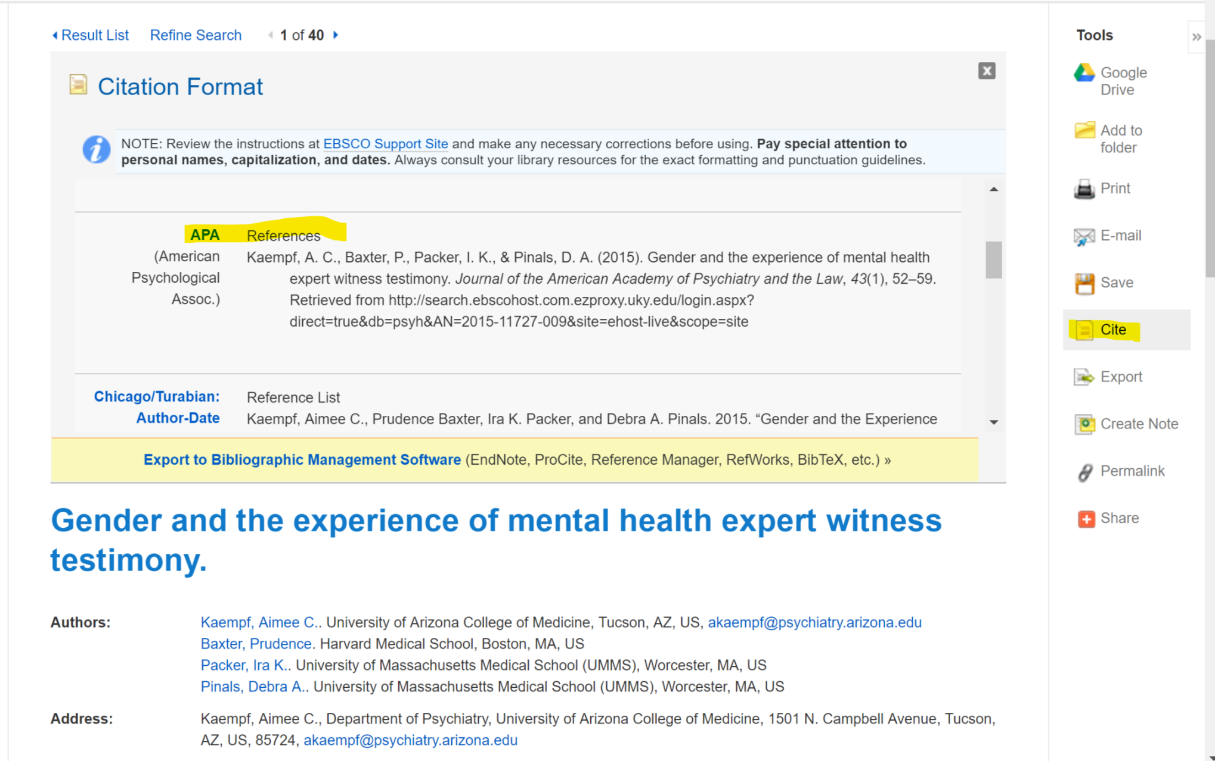
Notes:
The great thing about the database is that you can basically copy and paste the reference from the article’s detailed record.
Make sure you use the APA option, and double check it against your APA publication manual in case it’s not correct.

Slide 6
APA Stuff
Times new roman, 12 pt font
Double spaced (no extra line spacing)
Running head and page number on each page
NEVER say “proved,” in science, we find “support” for a hypothesis or theory
Scientific prose writing style
  Avoid being too wordy
  Judge other literature professionally
  Avoid redundancy
  Define initialisms and abbreviations

Slide 7
Citations
Last, F. M., Last2, F. M., & Last3, F. M. (Year). Article title. Italicized Journal Title, volume number, page numbers. doi: 10.blahblahblah
Hanging indents!!!!

Slide 8

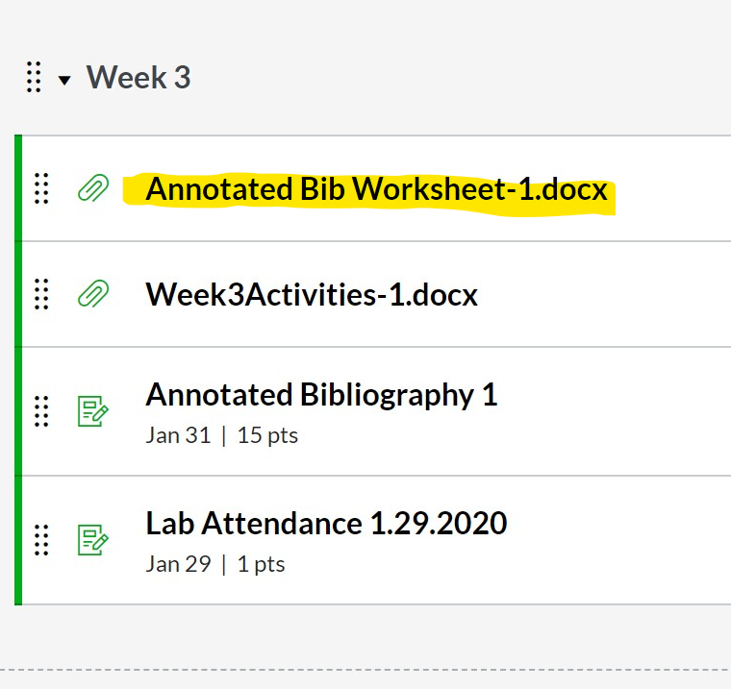
Annotated bibliography
Citation
Purpose of the study
Hypotheses of the study
Methodology
Major findings
Strengths, weaknesses, or biases
Relevance to your own topic
Notes:
I put the worksheet up in the week 3 module on CANVAS
It gives you a general idea of what to write about in your annotation
You don’t necessarily have to cover all of these topics in your annotations, but it’s a helpful place to start
You can read different articles than others in your group and then talk about them – but you should never cite an article that you haven’t read

Slide 9
Questions?

Slide 10
Attendance question
Module – Week 3 – Lab Attendance
Notes:
Put a correct APA formatted citation in the textbox or your attendance credit.

Slide 11
Hypothesis
What do you think will happen?
Should be informed by
  Previous research
  Observations of the way the world works

Slide 12
Methodology and Measures

Slide 13
Method
Correlational
  How connected are these two things?
  Correlation does not equal causation
Quasi-experimental Designs
  Nonmanipulated independent variables
  Random assignment is impossible
You can discover differences but CANNOT confirm causation

Slide 14
Method
Experimental Design
  Between vs. within subjects
  Allows you to (somewhat) infer causation

Slide 15
Measures
Discrete (categorical/nominal) vs. Continuous scales

Slide 16
Measures
http://libguides.uky.edu/psychology/databases
Ask yourself:
  Is it reliable?
  Is it valid?

Slide 17
Design an experiment
Make sure you are with your research group
Draw a magical number

Slide 18
Design an experiment
Peeing on a jelly fish sting alleviates the pain
If you cross your eyes for too long, they will get stuck that way
Bees are only attracted to the color yellow
Bulls hate the color red
If you pull out a grey hair two more will appear in its place
Sitting too close to the television screen will make you go blind
White wine with remove a red wine stain
Eating chocolate causes acne
Cracking your knuckles will give you arthritis
Spilling salt brings bad luck

Slide 19
Design an experiment
Define your independent and dependent variables
How will you measure these variables? (operationalize)
What is your hypothesis?
How would you test this experimentally? (pretend ethics don’t matter)

Slide 20
Before you leave
Do you know which article you will present in class?
Do you have any further questions on the annotated bibliography?
Do you have any questions about APA format?

